Slide 1
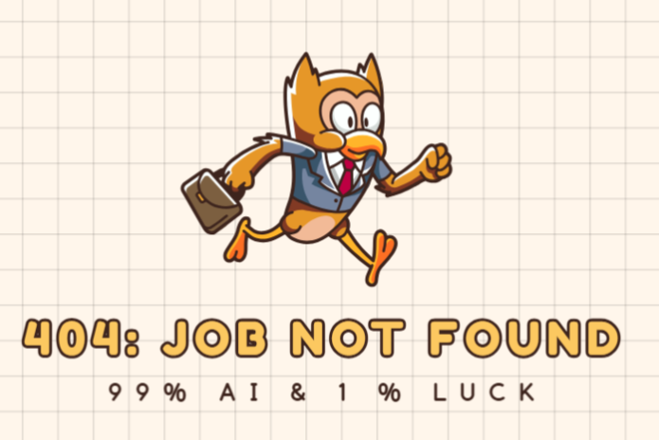
By - Sparsh Marwah, Neha Patil, Karan Dalal
Notes:
Karan: "You know that feeling when you apply for 25 jobs and only get one rejection email — if you're lucky? Yeah… we’ve been there.
That’s why we created a system that adds a little AI magic to all your hard work.
It’s 99% effort, 1% AI — but that 1%? It's doing the heavy lifting in the backend.
Today, myself Karan, and my friends, Neha and Sparsh, we’ll walk you through how we’re solving the job search problem using GenAI."

Slide 2
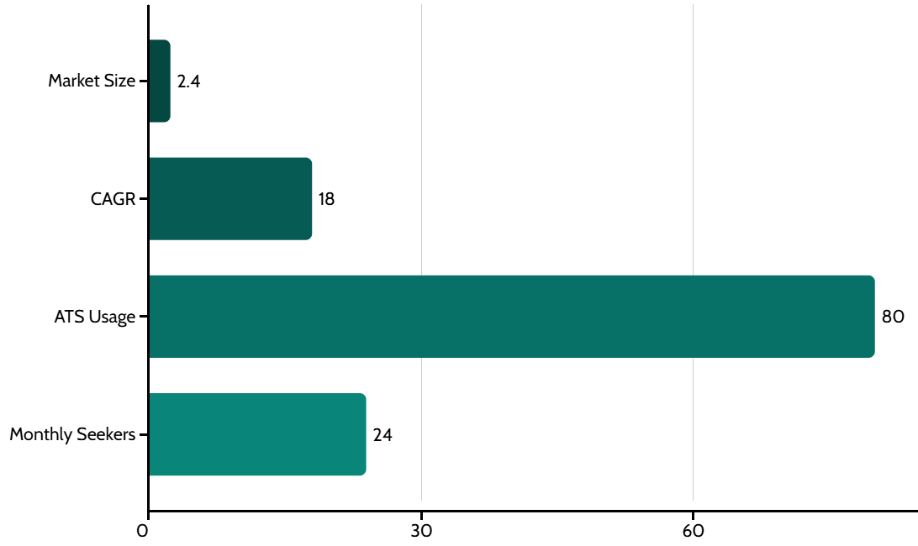



Current market
ATS Failure
Most resumes fail automated tracking systems
Feedback Gap
Candidates receive no improvement guidance
Applications
Average applications before landing a job
Global recruitment tech market will reach $2.4B by 2027.
Notes:
Karan: "Let’s be real — applying for jobs is painful. 60% of resumes don’t make it past Applicant Tracking Systems. And guess what? 0% of companies tell you why you got rejected. You end up playing resume bingo — rephrasing, rearranging, reapplying… Our research showed applicants submit 21 resumes on average before getting a single offer. So we asked ourselves: What if AI could bridge the gap between what you send... and what they want?"
🧠 (Optional engagement line): "Quick show of hands — how many of you have ever edited your resume and had no clue if it worked? Yeah, exactly." Karan: "Turns out, this problem is not just yours and mine — it’s global.
The recruitment tech industry is booming — projected to hit $2.4 billion by 2027.
And around 80% of employers use ATS tools already.
That means the problem isn’t going away — it’s scaling.
So our solution? Meet the job market where it is — with smarter tools, better insights, and feedback loops powered by AI.

Slide 3





Core Features
Resume Score
Job Match Intelligence
Real-time Suggestions
AI grades resumes on ATS compatibility (0-100 scale)
AI rankings for job matches (fit % per listing)
Instant skill and format improvements
Cover Letter
Chat
AI crafts cover letters tailored to each job (ready to download)
Get AI career guide for your queries.
Notes:
Sparsh: "Our platform is like a smart AI buddy for your job hunt — resume reviewer, coach, and recruiter all in one.
basically, you upload a resume — and walk out with a full application toolkit.
First, it checks if your resume is ATS-safe.
Then it scores your resume against any job description using AI — on a 0–100 scale.
Low score? No worries. Our Feedback Agent tells you what’s missing — like keywords or weak formatting.
Next, it finds top-matching jobs and ranks them by fit.
Then — it generates a custom cover letter for each job you like.
And if you're ever stuck, our built-in chatbot is ready for career questions like 'Should I include my GPA?' or 'Is this experience even relevant?"

Slide 4
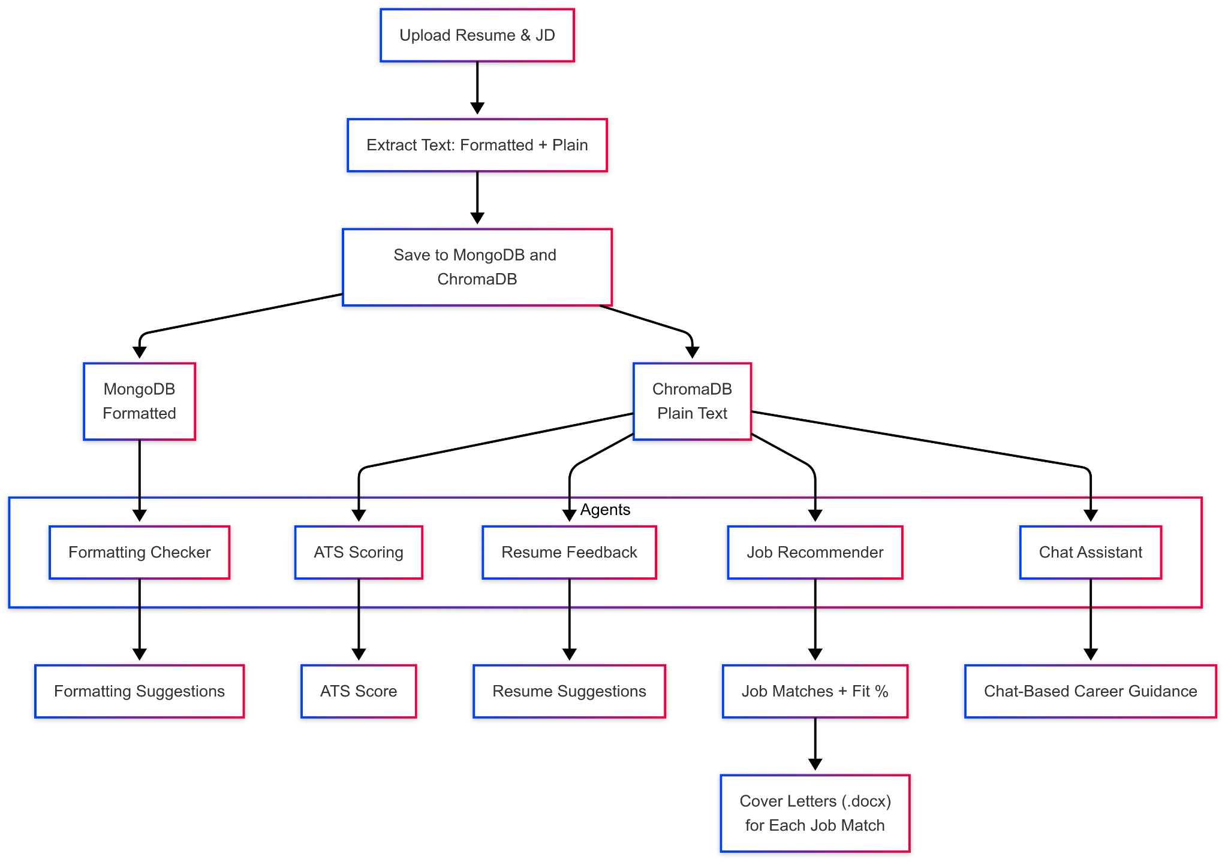
Workflow
Notes:
Sparsh: "This is what happens behind the scenes. We start with a resume and job description — we extract formatted and plain text, then store it in MongoDB and ChromaDB. From there, our agents kick in. Formatting Checker ensures ATS-friendly structure. ATS Scoring and Resume Feedback provide scores and suggestions. The Job Recommender finds matched jobs and instantly generates tailored cover letters. And the Chat Assistant offers personalized career guidance — in case you're ghosted again."
🎯 Optional fun line to end with: "Think of this as your personal AI job squad — always working, never sleeping."

Slide 5
DEMO

Slide 6








User Impact and Metrics
Score Improvement
Save Time
Cuts down resume rework and manual checks during job search and application
Boosts resume-to-JD alignment using ATS-style scoring and keyword matching
Confidence & Satisfaction
Efficiency Gain
Fewer iterations to reach job-ready documents and information
Designed to be helpful, responsive, frustration-free
Notes:
Neha: " So what’s the effect? Our system doesn’t just give scores — it delivers results that matter.
It improves resume-to-JD alignment, helping users target roles more precisely.
It saves time by cutting down all the guesswork and back-and-forth edits.
It speeds up job readiness — fewer rewrites, faster applications.
And most importantly, it boosts user confidence. With clear, AI-backed suggestions, users feel guided — not ghosted.”

Slide 7


Team 8

